Slide 1
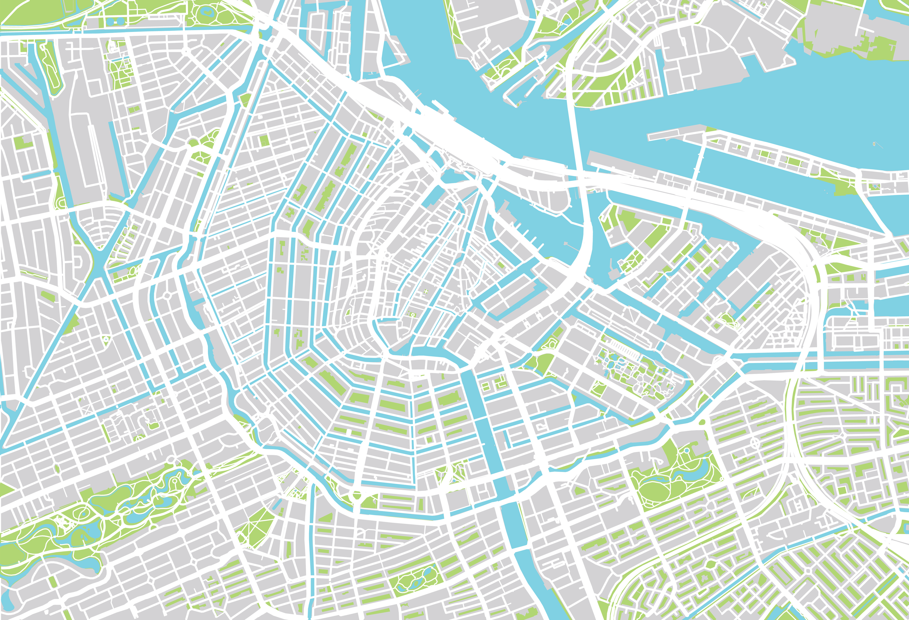

Awesome Vegan Food in Amsterdam
Saint-Jean Deli
(bakery)
Café de ceuvel
Plant Based
Sushi
Madre (Mexican)
Central Station
Jordaan
TerraZen
(fusion)
Frederik hendrikstraat
Ramen Impossible
Maoz (falafel)
Bonboon
(diner)
Flower Burger
Dam square
Piet Heinkade
Prins Hendrikkade
Men’s Impossible
(ramen)
Vegan Sushi Bar
Meatless District
Soil Vegan Cafe
Bloem (diner)
Vegitalian
(Italian)
Hortus
Botanicus
Wittenburgergracht
Vegan Junkfood bar
Maoz (falafel)
Rembrandt square
Veganees
(Asian Fusion)
Vegan Temple Bar
(burgers, bowls, wraps)
Utrechtsestraat
Weesperstraat
Primo Pasta
Amsterdam
Vegan Junkfood bar
Vijzelstraat
Oosterpark
Rainbowls (health food)
Hearth
(diner)
Vondel Park
Museum square
Helin’s Vegan Doner
The Old Soul (Surinamese)
Linneasustraat
De pijp
Mastino
(Pizza)
Junk food
Wild & The Moon
(lunch)
Semi-healthy
Trevi’s
(Italian)
Healthy
For world-wide restaurants with vegan food options install the free app:

